Slide 2
WATER RESOURCES MANAGEMENT
AT
DEBSWANA DIAMOND COMPANY
“Water Use in The Mining Sector”
Mike Brook
Hydrogeology Manager, Debswana, P.O.Box 329, Gaborone, Botswana
E-mail Mbrook@debswana.bw

Slide 3
PRESENTATION OUTLINE
Current Water Resources & Use
Debswana’s Water Strategy
Groundwater Initiatives
Lessons Learnt
WATER PITSO Selebi - Phikwe, 9th June, 2011

Slide 4
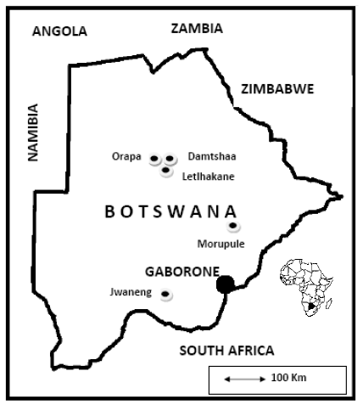
DEBSWANA OPERATIONS
    JWANENG MINE
    LETLHAKANE MINE
    ORAPA MINE
    DAMTSHAA MINE
    MORUPULE COLLIERY
WATER PITSO Selebi - Phikwe, 9th June, 2011

Slide 5
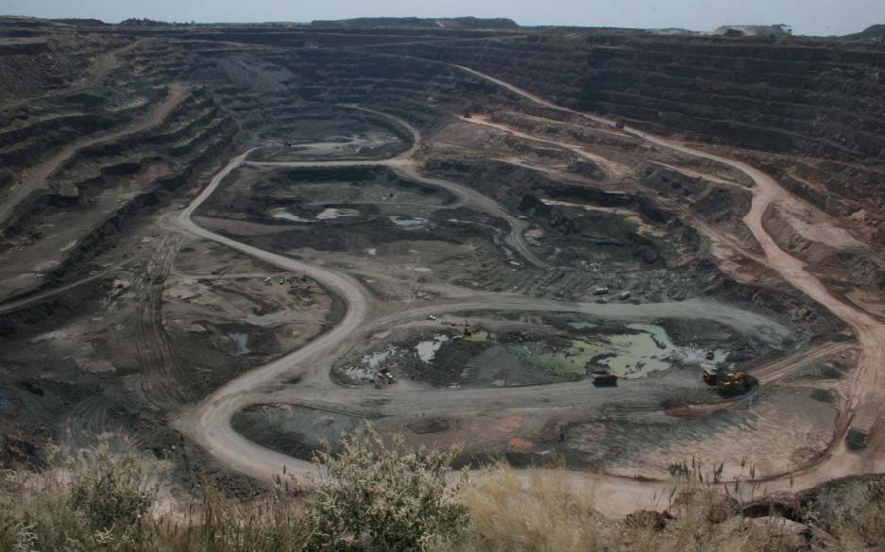
ORAPA MINE – AK1
WATER PITSO Selebi - Phikwe, 9th June, 2011

Slide 6
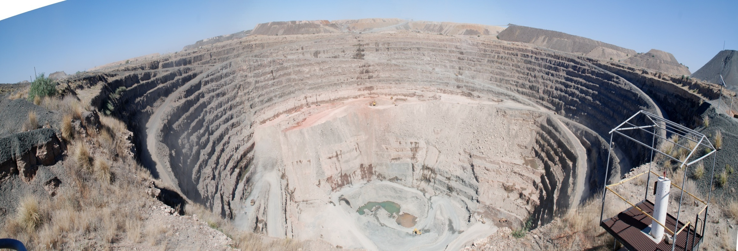
LETLHAKANE MINE – (DK1) & DK2
WATER PITSO Selebi - Phikwe, 9th June, 2011

Slide 7
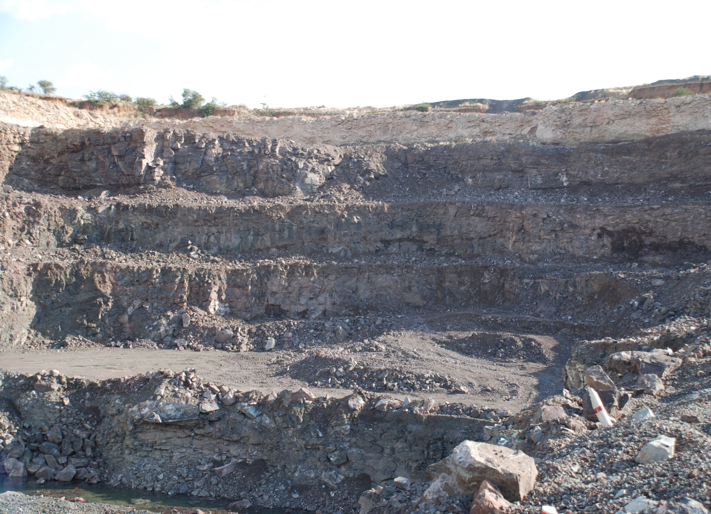
DAMTSHAA MINE – (BK9) & BK12
WATER PITSO Selebi - Phikwe, 9th June, 2011

Slide 8
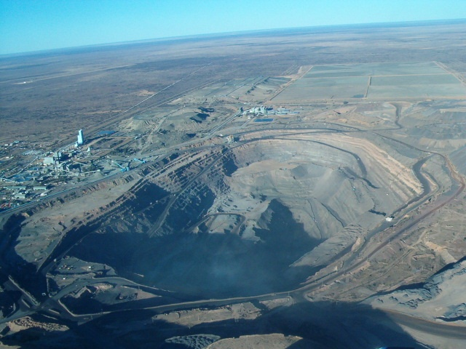
JWANENG MINE – DK2
WATER PITSO Selebi - Phikwe, 9th June, 2011

Slide 9
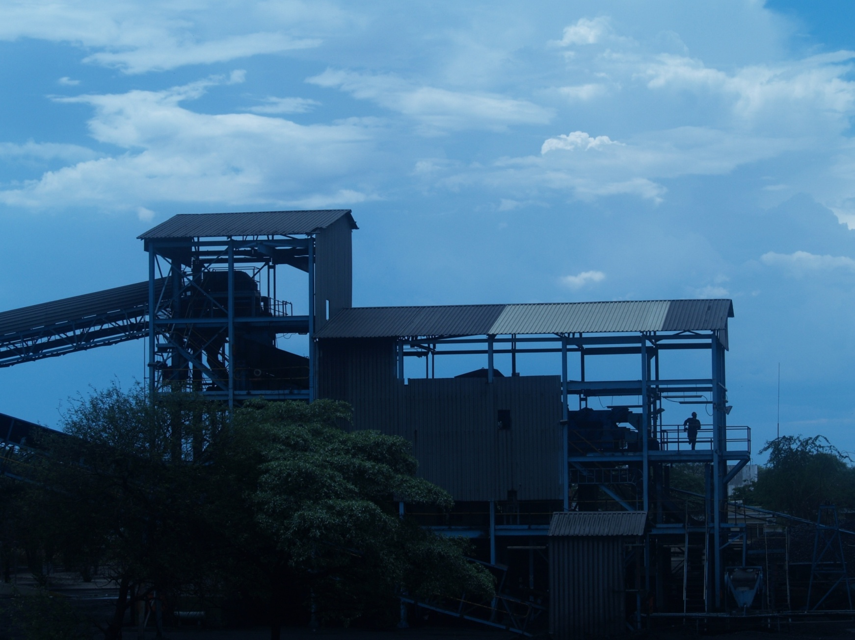
MORUPULE COLLIERY - PALAPYE
WATER PITSO Selebi - Phikwe, 9th June, 2011

Slide 10
BOTSWANA’S WATER USE PER SECTOR
WATER PITSO Selebi - Phikwe, 9th June, 2011

Slide 11
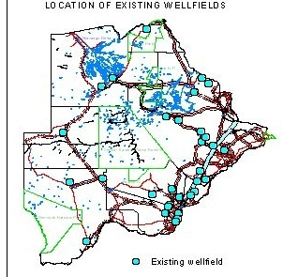
BOTSWANA’S EXISTING WELLFIELDS
WATER PITSO Selebi - Phikwe, 9th June, 2011

Slide 12
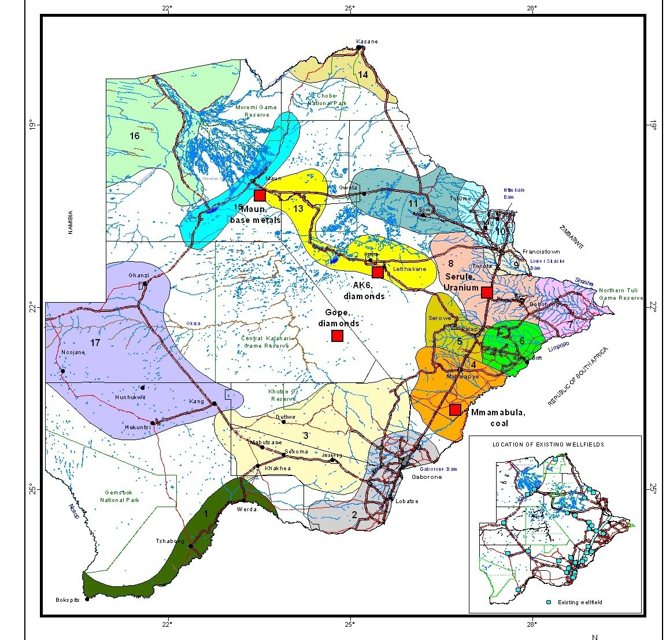
BOTSWANA’S NEW MINES
WATER PITSO Selebi - Phikwe, 9th June, 2011

Slide 13
CONTRIBUTION OF DIAMOND MINING
TO BOTSWANA’S ECONOMY - 2010
95% Mineral Revenue
80% Export Earnings
40% Government Revenue
33% GDP
Only <10% of the 250Mm³/yr Water Consumed with a return of approx P1640/m³.
Compared to agriculture – uses 37% water and contributes only 4% to GDP
Elsewhere – ADE- 52% use gives only 1.6% contribution to GDP
WATER PITSO Selebi - Phikwe, 9th June, 2011

Slide 14
DEBSWANA INTERESTS IN WATER RESOURCES
NO WATER NO DIAMONDS
Water resources development from wellfields which provide for the bulk of water supply for domestic and mine plant requirements
Pit dewatering for pit stability control and depressurization.
Water in current mine treatment processes and the development of new water conservation methods which are critical to the overall water management strategy
Protection of water sources and resources from the environmental impacts of mining activities.
WATER PITSO Selebi - Phikwe, 9th June, 2011

Slide 15
DEBSWANA WATER SOURCES
11 dedicated water supply wellfields >200 production and as many observation boreholes – 20Mm³/yr
Reverse Osmosis treatment
6 open pit diamond Mine dewatering systems, >100 boreholes produce 3.7 Mm³/yr, 3.4 Mm³/yr sump pumping
>50 angled drain holes passive inflows
Rainfall and Storm – Water Harvesting
Recycled water (slimes)
WATER PITSO Selebi - Phikwe, 9th June, 2011

Slide 16
DEBSWANA WATER CONSUMPTION
(Mm3/yr)
WATER PITSO Selebi - Phikwe, 9th June, 2011

Slide 17
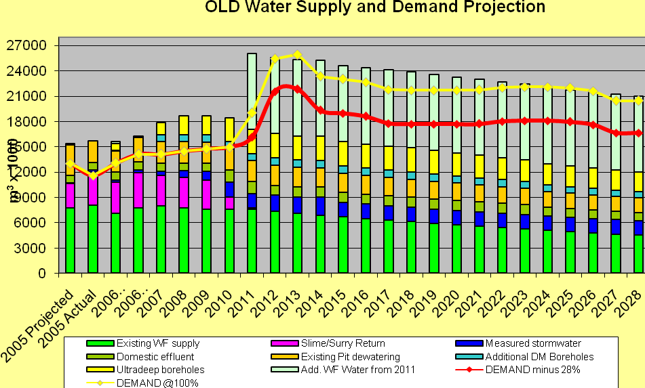
PLANNING FOR THE FUTURE
WATER PITSO Selebi - Phikwe, 9th June, 2011

Slide 18
DEBSWANA WATER & RESIDUE STRATEGY
2005-2030
VISION
“finished residue product that minimises new water intake, deposited in a safe, environmentally acceptable and cost effective manner”
MISSION
“To minimise new water intake and impact on the environment for sustainable development”
WATER PITSO Selebi - Phikwe, 9th June, 2011

Slide 19
DEBSWANA WATER POLICY 2011- OBJECTIVES
To achieve an overall reduction in raw (new) water
use per cubic meter of ore processed.
To continually improve water management at all Group operations in line with Debswana’s Water and Residue strategy, international benchmarks and best practices.
To promote water conservation, demand management, water use efficiency and rationalisation of water use.
Minimise environmental impact from the Company’s water consumption in line with its SHE Policy.
WATER PITSO Selebi - Phikwe, 9th June, 2011

Slide 20
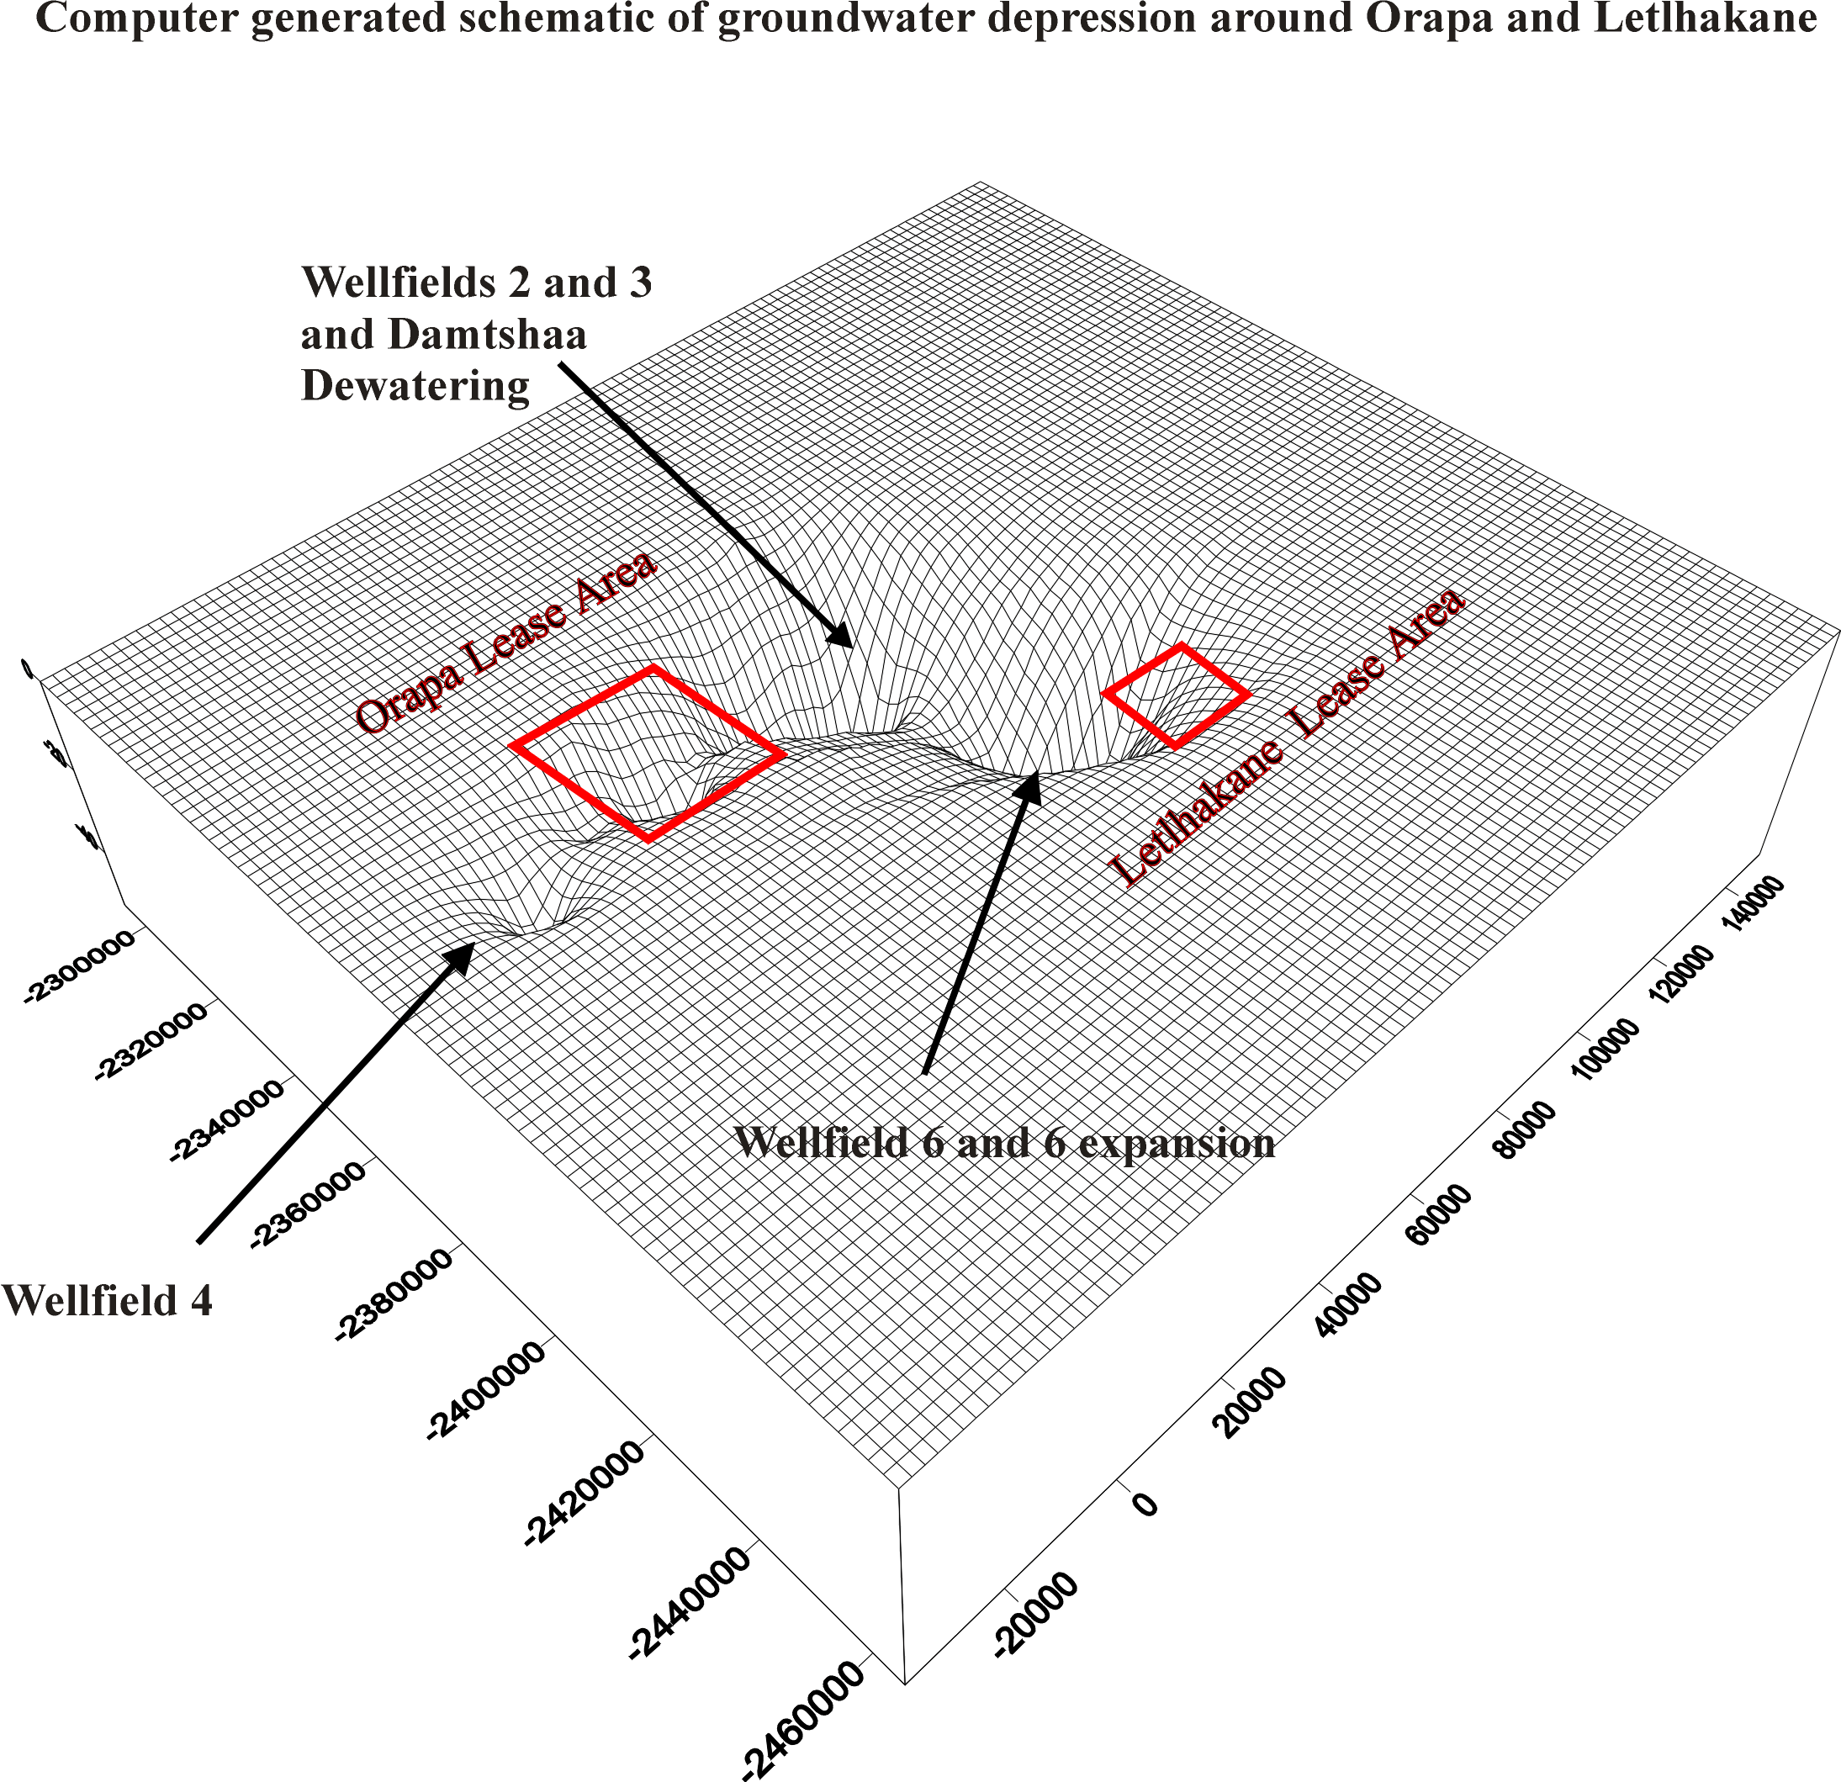
IMPACTS ON OTHERS
All Debswana well field abstractions have approved water rights for abstraction granted by the Botswana water apportionment Board.
All water rights are linked to compensation agreements with other private users in the general areas
Debswana adheres 100% to these agreements – there has been very little impact to other users over the last 30 years of abstraction
WATER PITSO Selebi - Phikwe, 9th June, 2011

Slide 21
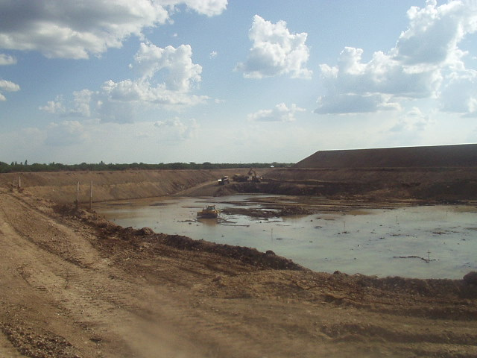
MITIGATION AGAINST IMPACTS ON
WATER RESOURCES
DEVELOPOMENT OF ALTERNATIVE – NON –CONVENTIONAL WATER RESOURCES e.g. 2009 RAINFALL – STORMWATER HARVESTING DAM AT ORAPA - cited as excellent example of rainfall harvesting in National scoping report for UNDP – GOB IWRMP,
AS follows:
“In 2009, Orapa and Letlhakane Mines commissioned
the construction of a million cubic metre storm water
dam whose primary objective is to harvest rainwater.
Much of Orapa's surface area is paved, and because
the water is being collected from running water and
rooftops, it is an advantage to the project.
The project has the potential to recover the total project
cost in about two years. The project cost is P58 million.
So far in the first year, the total cost benefit is P38.9 million.
The project is likely to recover the investment in less
than two years.”
WATER PITSO Selebi - Phikwe, 9th June, 2011

Slide 22
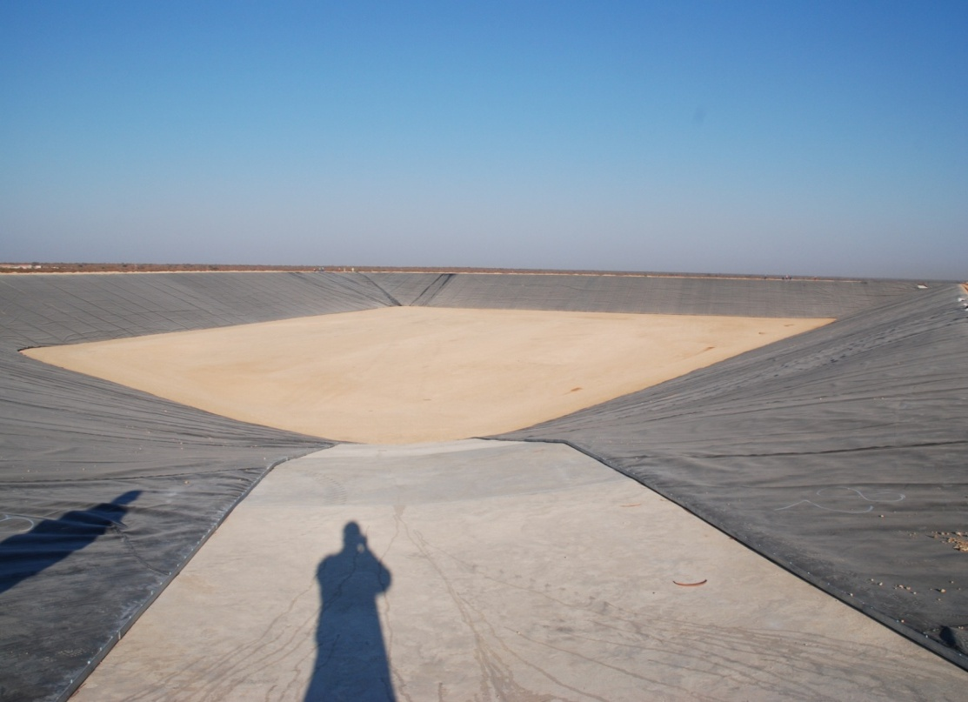
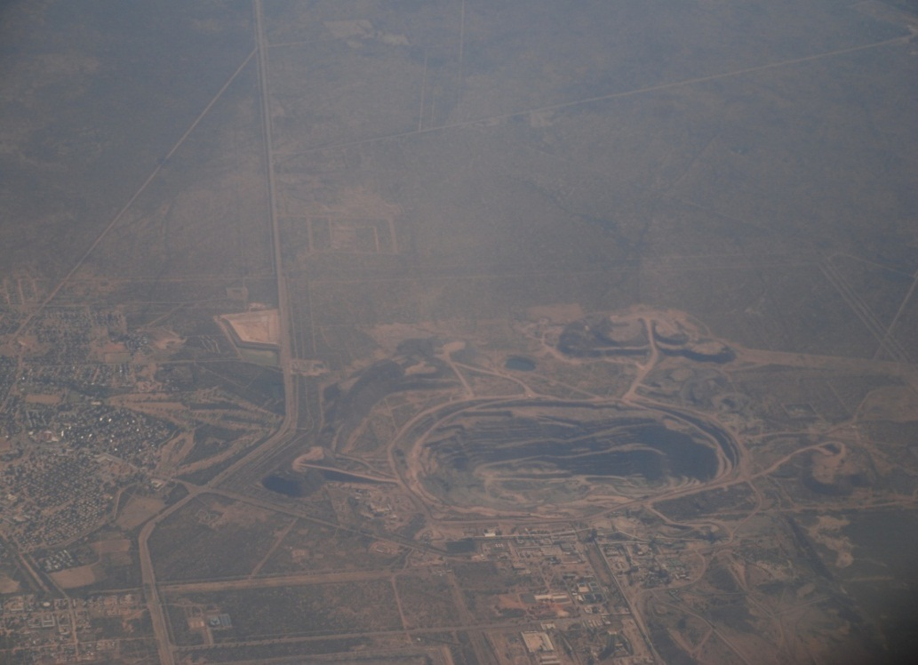
ORAPA STORMWATER HARVESTING DAMS
WATER PITSO Selebi - Phikwe, 9th June, 2011

Slide 23
Cost Benefit
Total Project Cost – P58 M
Planned to drill 26 boreholes at Well field 7
Project Cost |  | 140,000,000
Number of Boreholes |  | 26
Cost Per Borehole (Geophysics/Siting, drilling, pump testing and infrastructure) |  | 5,384,615
Average pumping Rate (m³/hr) |  | 20
Average Annual Water per borehole |  | 140,160
Water Harvested |  | 1,000,000
Number Boreholes Required to supply (1000000/year) |  | 7
Benefits |  | 38,417,633
Maintenance Savings (less cost of maintaining dam pumps) |  | 500,000
Year 1 cost benefit |  | 38,917,633
WATER PITSO Selebi - Phikwe, 9th June, 2011

Slide 24
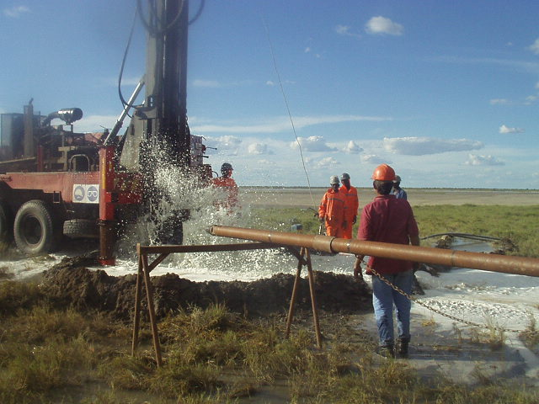
MITIGATION AGAINST IMPACTS ON
WATER RESOURCES (contd.)
ALTERNATIVE WATER SOURCES– SALINE GROUNDWATER WORK UNDERTAKEN AT JWANENG (DESK TOP) & ORAPA (FIELD INVESTIGATIONS)
Boteti Area 45km NW OF ORAPA
12 Boreholes drilled
Drill yields average 40m³/hr
TDS 108,000 Mg/l
OVER 450Mm³ , EASILY MEET WATER DEMANDS
FOR LIFE OF MINES
A 2011 STUDY IS PROPOSED TO ASSESS
TECHNICAL FEASIBILITY OF DESALINATING THIS
RESOURCE FOR PROCESS USE.
WATER PITSO Selebi - Phikwe, 9th June, 2011

Slide 25
MITIGATION AGAINST IMPACTS ON
WATER RESOURCES
Working partnerships established with Department of Water Affairs Technical Committees to collaborate on joint exploitation of shared groundwater resources at Jwaneng and Orapa e.g. Using common groundwater models.
Continuous groundwater monitoring and assessment at all operations.
Continued exploration for new well field developments in the Ntane Sandstone regional aquifer system e.g. Well field 8 at Orapa.
WATER PITSO Selebi - Phikwe, 9th June, 2011

Slide 26
  NEW STRATEGIC PLAN & DEBSWANA WATER USE OPTMISATION STUDIES
  WORKSHOPS/FORUMS ON WATER
  FORMATION OF WATER STRUCTURES AT THE MINES
  STRATEGIC GROUNDWATER TECHNICAL PARTNERSHIP
  IMPLEMENTATION STRATEGY BOBS DEBSWANA DRINKING WATER STANDARDS
INITIATIVES
WATER PITSO Selebi - Phikwe, 9th June, 2011

Slide 27
  STRATEGIC HIGH LEVEL MINE DEWATERING/DEPRESSURIZATION PARTNER
  STRATEGIC PASTE THICKENING PARTNER
  STRATEGIC DRILLING PARTNER
  RAINFALL / STORM WATER HARVESTING
  WATER RESOURCES DATABASE IMPLEMENTATION
  UPGRADE TO ORAPA’S DOMESTIC WATER SUPPLY (Desalination)
INITIATIVES
WATER PITSO Selebi - Phikwe, 9th June, 2011

Slide 28
  Comprehensive Monitoring and modelLing of the national resource in the areas of operation
  ON AVERAGE, 15 PROJECTS A YEAR UNDERTAKEN IN THE FIELD OF GROUNDWATER ASSESSMENT & MANAGEMENT
  BOREHOLE REHABILITATION PROGRAMMES
  IMPLEMENTATION OF BOBS DRINKING WATER QUALITY STANDARDS AND MONITORING PROGRAMES THROUGH SERVICE LEVEL AGREEMENTS
  EXPLORATION & ASSESSMENT OF “INDUSTRIAL” WELLFIELDS
GROUNDWATER INITIATIVES
WATER PITSO Selebi - Phikwe, 9th June, 2011

Slide 29
LESSONS LEARNT
To cater for maintenance, failures etc., up 15% additional resource need to be planned for
Groundwater development is a long process and needs to be planned for well in advance of water requirements
Debswana needs to plan for the development of alternative water resources to the existing wellfields within the next 5-10 years e.g. storm-water/ rain water harvesting, Industrial (brackish + saline) wellfields etc
Paste thickening will be an expensive exercise and may not be able to achieve the water conservation that has been expected
WATER PITSO Selebi - Phikwe, 9th June, 2011

Slide 30
LESSONS LEARNT
Public awareness and education campaigns on water conservation and rationalisation of water use need to be continuous and aggressive in order to have an effect
IWRM needs to be implemented at all operations
Development of partnerships e.g. groundwater, dewatering & drilling are crucial to cost effective and efficient WRM at Debswana operations
Development & Maintenance of a comprehensive water database is crucial for effective WRM
WATER PITSO Selebi - Phikwe, 9th June, 2011

Slide 31
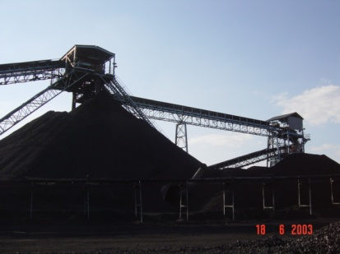
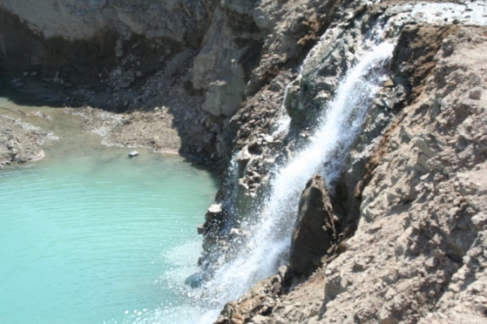
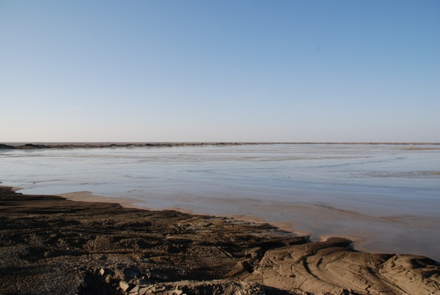
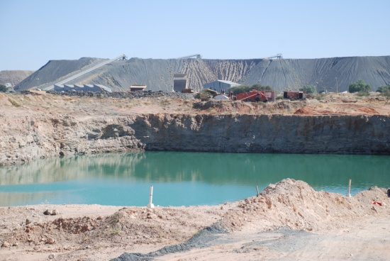
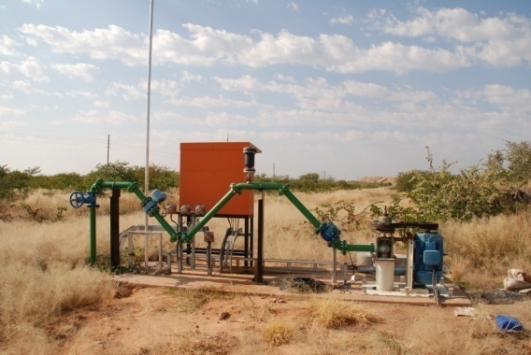
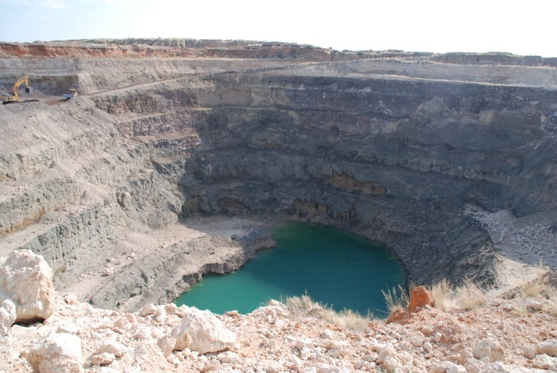
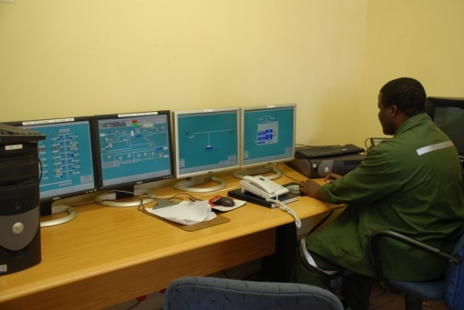
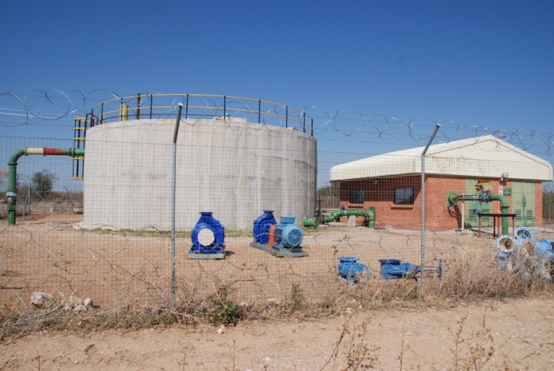
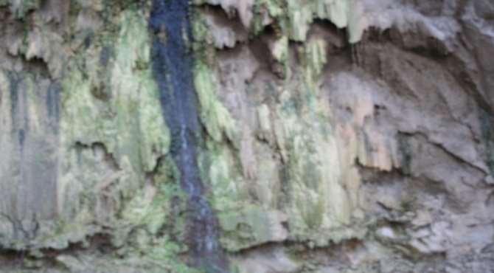
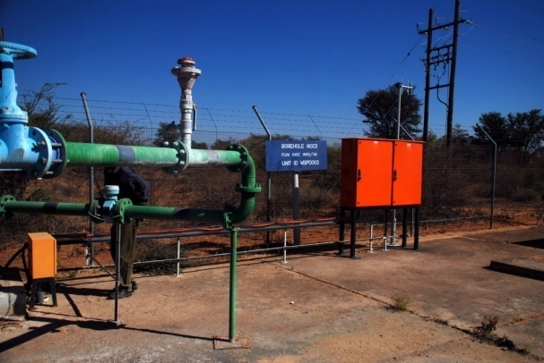
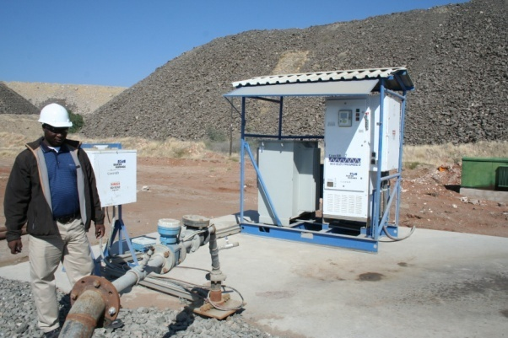
THANK YOU
WATER PITSO Selebi - Phikwe, 9th June, 2011
Notes:
31
The end
There is no doubt that the Debswana Group is faced with considerable challenges in meeting the requirements of its own strategic plan for water & residue management. However, trends of water conservation over the last few years are extremely encouraging. The Group continues to make available the necessary financial and technical resources in order to succeed and the required actions are now in place – as a major Botswana water user, we must lead by example!!!

